Slide 1
A presentation outlining key Crop Protection Products and Positioning

Slide 2

Add BLITZ to glyphosate to control volunteer RR canola, wild buckwheat, and dandelion while enhancing control of chickweed, cleavers, sheperds purse, smartweed and stinkweed.
ACTIVE INGREDIENT
50g/L private label Group 2 Florasulam
DIRECTIONS FOR USE
Apply BLITZ herbicide at 40 ml/ac (100 ml/ha) and glyphosate at 182.2 g a.e./ac (450 g a.e./ha) with 10 US gal of water per acre (100 L/ha).
PACKAGE SIZE
3.2 L jug treats 80 acres

Slide 3
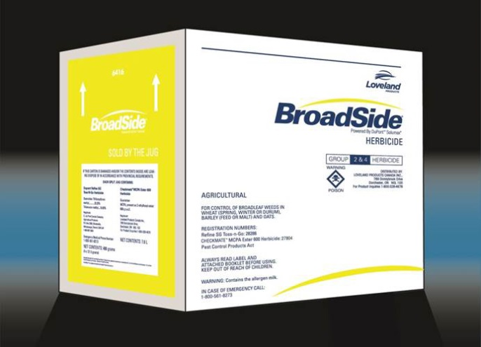
BROADSIDE
Jug Size | Active | Similar to | Crops | Weeds Controlled | Timing | Rate
486 gr +7.6L MCPA Ester | Thifensulfuron methyl + Tribenuron methyl Group 2,4 | Refine M | Barley, Oats, spring wheat, durum, winter wheat | Wild mustard, Wild buckwheat, stink weed, russian thistle, lambsquarters, redroot pigweed, lady's thumb, flix weed, dandelion | Full 3 leaf to flag emergence | 12 gr/acre + 190 mL MCPA Ester

Slide 4
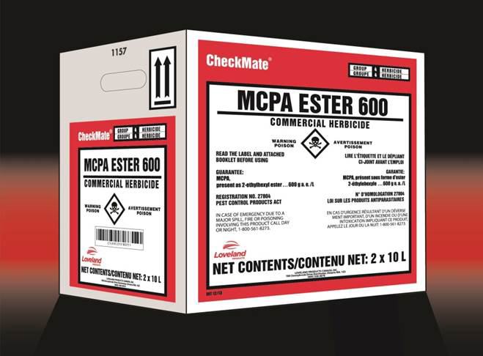
CHECKMATE
Jug Size | Active | Crops | Weeds Controlled | Timing | Rate
10L; 115L | 600g/L present as 2-ethyl hexyl ester Group 4 | Wheat, Barley, Rye, Oats, Flax, established forages | Lambs quarter, flixweed, stinkweed, Annual sow thistle,Kochia, Canada thistle, pigweed, hemp nettle | 3 leaf to early flag | 235ml - 3.7L/acre see label for specific crop and weed rates

Slide 5

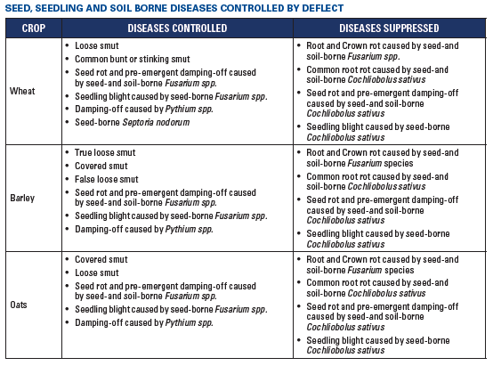
DEFLECT seed treatment is a combination of the systemic fungicides, tebuconazole and metalaxyl which control certain seed, seedling, and soil borne diseases of wheat, barley and oats.
ACTIVE INGREDIENT
tebuconazole...............................5.0 g/L
metalaxyl.....................................6.6 g/L
Use 300 ml of DEFLECT per 100 kg of seed.

Slide 6

DUET™ herbicide is the first choice for effective grassy and residual broadleaf weed control in Clearfield® branded crops, Field Peas, Fababeans and Soybeans. DUET can be tank mixed with Group 1 herbicides for added grassy weed control.
CROPS
Clearfield® branded crops
Field pea; Fababean
Soybeans
ACTIVE INGREDIENT
Imazamox & Imazethapyr – Group 2
PACKAGE SIZE
40 acres per box or 160 acres per case
8 X 86.5 g water soluble bags

Slide 7

ACTIVE INGREDIENTS
Propiconazole – fungicide Group 3
CROPS
Canola, Wheat (including spring, winter and durum), Barley, Oats and Canary Seed.
FORMULATION & PACKAGING
Each case of Fitness contains 2 x 4.8L jugs.
Each jug treats:
40 acres at the full rate (0.12 L/ac)
80 acres at the half rate (0.06L/ac) (as a tank mix partner at herbicide timing)

Slide 8

Jug Size | Active | Similar to | Crops | Weeds Controlled | Timing | Rate | Notes
7.57L ,121 L | Clodinafop-propargyl | Horizon NG Ladder Signal | Spring wheat, Durum | Wild oats barnyard grass persian darnel green foxtail yellow foxtail | 1-6 leaf, before 4th tiller | 376-473 mL/acre | Surfactant is built into product, do not need to add additional surfactant

Slide 9

Product | Registered Pesticides | Adjuvant Rate/ 1000L Water | Adjuvant Properties | Adjuvant Benefits
LI-700 80% Non-ionic formulated with Leci-Tech, pH reducing | ASSURE II GLYPHOSATE EVEREST 2.0/SIERRA 2.0 REGLONE/STAGE/DIQUASH ADMIRE 240 ASSAIL CYGON 480/LAGON 480 MALATHION POUNCE RIPCORD SEVIN XLR | 5 L 2 – 5 L 2.5 L 2.5 L 300 mL 900 mL 500 m L 600 mL 600 mL 300 mL 600 mL | Acidifier (pH reduction) Deposition Aid/Sticker Drift Control Penetrant Spreader | Reduced Drift by reducing production of small droplets Lowers water pH ensuring pesticide efficiency Spreading and adhesion properties ensure the pesticides stays on leaf Penetrates through waxy leaf cuticles
Always read and follow manufacturers’ label directions

Slide 10

Product | Registered Pesticides | Adjuvant Rate/ 1000L Water | Adjuvant Properties | Adjuvant Benefits
Liberate 100% Non-Ionic Surfactant, neutral pH, formulated with Leci-Tech *Use where a non-ionic surfactant is recommended on the pesticide label | ACCENT ADRENALIN ALLY DEPLOY/ NUFARM BOOST DISTINCT DUAL MAGNUM GLYPHOSATE FOLICUR/PALLISER/FUSE EXPRESS SG/NUANCE EXPRESS PRO ODYSSEY PURSUIT REFINE REFLEX RETAIN SG | 2 L 2.5 L 2 L 2 L 2.5 L 1 L 2.5 L 1.25 L 2 L 3.5 L 2.5 L 2.5 L 2 L 1 L 2 L | Deposition Aid/Sticker Drift Control Penetrant Spreader | 100% active spreader/penetrant contains soy oil derivative Odorless, low-foaming, neutral pH formulation Provides drift reduction, increased droplet adhesion, Excellent penetration and deposition and is user friendly
Always read and follow manufacturers’ label directions

Slide 11

Jug Size | Active | Similar to | Crops | Weeds Controlled | Rate
8L + 4L turbocharge | tralkoxydim | Liquid Achieve, Bison, Nufarm Traloxydim | Barley, durum, spring wheat, triticale, winter wheat, spring/fall rye | wild oats, barnyard grass, persian darnel, green foxtail, yellow foxtail | 40 acres/case 200mL/acre plus .5% v/v Turbocharge

Slide 12
MCPA AMINE 600
TRIED AND TRUE BROADLEAF WEED CONTROL
MCPA AMINE 600 is a cost-effective herbicide that controls a wide range of broadleaf weeds in peas, oats, flax, cereal grains, field corn, seedling and established grasses, and rangelands. It is useful for controlling weeds when establishing legumes that are undersown to small grains. MCPA AMINE 600 is an effective broadleaf herbicide for managing herbicide resistant weeds.
GUARANTEE
MCPA 600 g a.e./L (present as dimethylamine salt)
PACKAGE SIZE
2 x 10 litres

Slide 13

CUSTOMIZED BROADLEAF WEED CONTROL
Move over old standards…MOMENTUM™ herbicide “raises the bar for broadleaf weed control for wheat and barley growers. With its tank-mix flexibility, MOMENTUM provides unparalleled tailor-made performance, especially on those tough-to-control broadleaf weeds like Canada thistle, cleavers, wild buckwheat and kochia.
Active Ingredients | Crops | Weeds Controlled | Application Timing | Rate
• Fluroxypyr –Group 4 • Clopyralid – Group 4 | Wheat (spring, durum) Barley | • Canada thistle • Cleavers • Kochia • Volunteer flax • Wild buckwheat | Apply to crop from 3-leaf to just before flag leaf | 0.45L/acre (20 ac/jug) (240 ac/shuttle)

Slide 14

Mizuna® herbicide is the first choice for effective grassy and broadleaf weed control in Clearfield® branded crops. Convenient packaging and flexible rotation, Mizuna can be tank mixed with Group 1 herbicides for added grassy weed control.
CROPS
Clearfield® branded crops
ACTIVE INGREDIENT
Imazamox – Group 2
PACKAGE SIZE
40 acres per box or 160 acres per case

Slide 15

Product | Registered Pesticides | Adjuvant Rate/ 1000L Water | Adjuvant Properties | Adjuvant Benefits
MSO with Leci-Tech Leci-Tech blend of modified vegetable oil and surfactant | AIM HEAT WG ODYSSEY VALTERA YUMA CORAGEN/BENEVIA | 2.5 L 0.4 L/acre 1 L 1.01 L/acre 5 - 10 L 5 L | Deposition Aid/Sticker Drift Control Penetrant | Enhanced penetration and droplet adhesion for increased plant uptake and optimum weed control. Its premium emulsifiers and the addition of LECI-TECH provide uniform mixing and drift reduction.
Always read and follow manufacturers’ label directions

Slide 16

Jug Size | Active | Similar to | Crops | Diseases Controlled | Rate | Notes
9.5L | Tebuconazole | Folicur 250 | Wheat, Barley, Oats, Soybeans | Suppression of Fusarium head blight, Septoria glume blotch, stripe rust, leaf rust, septoria, tan spot, powdery mildew, net blotch scald, Asian soybean rust | 89-118mL/acre + Non-ionic surfactant 0.125% v/v | Surfactant is not built into palliser, must add in (Liberate)

Slide 17

Jug Size | Active | Similar to | Crops | Weeds Controlled | Timing | Rate
486 g 4.8L Fluroxypyr 8L 2,4-D Ester | Thifensulfuron + Tribenuron Attain A-Fluroxypyr – Attain B- 2,4-D Ester Group 2, 4 | Attain plus Refine SG | Spring Wheat, Durum, Barley | Canada Thistle, Kochia, lady's thumb, lambs quarters, narrow leaved hawks beard, volunteer flax, wild buckwheat, wild mustard, sow thistle | 4 leaf to flag leaf | 8 gr/acre Retain Attain A 0.12L/acre Attain B 0.2L.acre

Slide 18
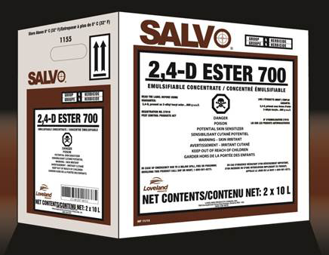
SALVO
Jug Size | Active | Similar to | Crops | Rate | Notes
10L, 115L, 205L | 660g/L 2,4-D Ester Group 4 | 2,4-D Ester | Wheat, Barley, Rye, Corn, established grasses | 0.2L to 2.75L/acre See label for specific rates for crpo and weeds | Best weed control occurs when temperatures are about 21º C daytime or 10º C nighttime and humidity is above 70%. Do not apply if temperatures are above 27º C.

Slide 19

Jug Size | Active | Similar to | Crops | Weeds Controlled | Rate
3L Clethodim, 9L Surfactant | Clethodim + Surfactant | Centurion, Arrow, Select | Field Peas, Dry beans, Potatoes, sunflowers, soybeans, mustard, flax, lentils, chickpeas | Volunteer cereals, wild oats, green foxtail, yellow foxtail, barnyard grass, quack grass (suppression) | Maximum Rates Chickpeas, dry beans-76mL all other crops 152mL/acre

Slide 20

Exclusive to CPS, STARTUP® is an excellent option for producers who are looking to protect their crop with a high quality glyphosate at a reasonable price. The highly concentrated formulation requires fewer litres per acre.
ACTIVE INGREDIENTS AND WHERE TO USE
Glyphosate, 540 grams acid equivalent per litre, present as potassium salt. STARTUP is a water soluble herbicide for non-selective weed control in pre-seed, in-crop (glyphosate-tolerant crops), pre-harvest and post-harvest applications.
Increase glyphosate performance, and reduce drift with the addition of LI700!

Slide 21

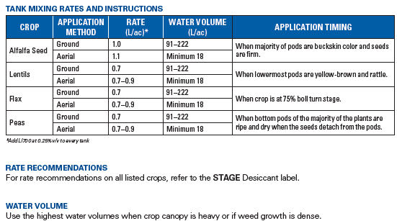
ACTIVE INGREDIENT
Diquat, 240 g/L. Present as dibromide.
PACKAGE SIZE
10 L Jug (2 x 10 L/case) and 115 L Drum
The use of STAGE™ desiccant allows the option of straight cutting and minimizes the loss
of grade and yield that can occur in swathed crops. Desiccation with STAGE, plus LI700®,
promotes faster and more uniform dry down, helping to retain good color.

Slide 22
SWORD
Jug Size | Active | Similar to | Crops | Weeds Controlled | Timing | Rate
10L, 160 L | MCPA + Mecoprop -P + Dicamba Group 4 | Target | Barley, Spring Wheat, oats, Durum, Winter wheat, Canary Seed | Volunteer canola, wild buckwheat, wild mustard, stinkweed, kochia, lady's thumb, lambsquarters, flix weed, annual sow thistle, shepard's purse, redroot pigweed | 2-4 Leaf (Barley) 2-5 Leaf (oats, spring wheat, durum) | 400-600 mL/acre

Slide 23

WILDCAT® ENHANCED herbicide is the value choice for effective grassy weed control
in cereals. Convenient and with a wide window of application, WILDCAT ENHANCED offers a wide choice of tank-mix partners. Get great control of green foxtail in wheat at an economical low rate too.
CROPS
• Spring wheat
• Durum wheat
• Spring barley
ACTIVE INGREDIENT
Fenoxaprop-p-ethyl 36 g/ac (90 g/ha)- Group 1
PACKAGE SIZE
1 L to 8.25 L/jug (2 jugs per case)

Slide 24

Product | Supported Pesticides | Adjuvant Rate/ 1000L Water | Adjuvant Properties | Adjuvant Benefits
Valid with Leci-Tech Leci-Tech anti-form/de-form non-ionic surfactant with drift control | LIBERTY | 1.25 L | Anit-foam/ De-foam Drift Control Deposition Aid/Sticker | Drift control adjuvant to enhance deposition, retention and control spray droplet size of agricultural and industrial chemicals. Non-ionic, non-foaming, and shear tolerant drift control agent containing suspended anti-foam/de-foamer
Always read and follow manufacturers’ label directions

